Slide 1

The Basics

Slide 2
This CLASs
Outline:
Introduction – What, Why, Who, Where, When, How
Basics – python files, syntax, assignment, imports
Data types – numbers, strings, lists, and dictionaries
Flow control – conditions and logic
Functions – reusable code
Program development
Course content, code samples, and tools
Notebook Viewer

Slide 3
resources
Packt publishing:
https://www.packtpub.com/
Free Learning – free technology book every day:
https://www.packtpub.com/free-learning
979 Python books:
https://www.packtpub.com/catalogsearch/result/?q=Python

Slide 4
Files
Python files end in .py
And some variants:
ArcGIS Python Toolbox - .pyt
Jupyter notebooks - .ipynb
Modules
Executable python files are referred to as modules.
Modules can be a single file or a collection of files.
A single-file module is often referred to as a script.
Many use the term module and script interchangeably.
Package (library)
A hierarchical collection of modules defining an application

Slide 5
Packages
module.py
sub_module_1.py
Hello_world.py
print_hello_world()
sub_module_2.py
print_stuff.py
print_stuff()
delete_stuff.py
delete_stuff()
import module
module.sub_module_1.hello_world.print_hello_world()

Slide 6
Syntax
Python has a style guide:
Python Enhancement Proposal 8 (PEP8)
https://www.python.org/dev/peps/pep-0008/
In general, use the style guide, though some rules are meant to be broken..
Style matters – it makes your code easier to read
Code is read far more often than it is written.

Slide 7

Syntax
PyThOn vArIabLes aRe CaSe sEnsitiVe
My_Variable is not equal to my_variable
Variables are declared with alphanumeric and ‘_’
No special characters
Comments:
Start with an ‘#’
Can be their own line or at end of a line
These are for documenting your code – Python ignores

Slide 8
Syntax
Blank lines
You can add blank lines at will - Python will ignore them
Useful for visually structuring code
White space (tabs and spaces – don’t mix!)
Generally ignored except when establishing code blocks
Indentation
Used to establish an executable code block
More on this later..

Slide 9
Assignment
The ‘=‘ sign assigns a value to a variable.
my_variable = 1000.0
Left side of the expression is the variable name.
Right side of the expression is the value that is assigned to it.

Slide 10
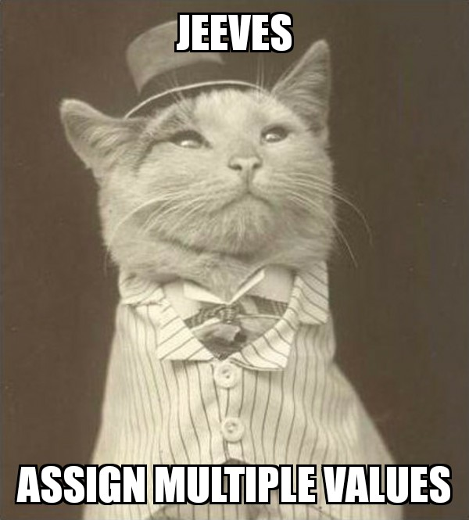
Assignment
If you fancy, you can assign values to multiple variables at once:
A = B = C = 1000.0
A, B = 1000, 2000

Slide 11
Assignment
Give your variables meaningful names!!
path_to_csv = r’C:\Users\mtroyer\Documents\csv_file.csv’
This sucks:
p = r’C:\Users\mtroyer\Documents\csv_file.csv’

Slide 12
imports
You can import and use code from other modules using the ‘import’ statement.
Imports go at the beginning of your script/module.
import arcpy
import arcpy as ap
from arcpy import Append_management
from arcpy import Append_management as append

Slide 13
imports
Technically you can import everything from a package by calling:
from package import *
This is a convenience – you can then type:
some_function()
Instead of
some_package.some_function()
Only naughty programmers do this though as it can create name conflicts.
Two packages may have functions with the same name.
In this case the last imported one overwrites the previous one.

Slide 14
imports
You can documentation associated with a package by calling help(package)
You can also see a list of all the submodules, functions, and variables defined in a package by calling dir(package)

Slide 15
Function basics
Calling functions is how we accomplish most things in Python.
Functions:
accept parameters
perform actions
return values
Sometimes the value is None

Slide 16
Function basics
They are roughly analogous to the concept of a mathematical function:
f(x) = x*3
Function name: f()
Parameter: x
Returns: x*3
F(10) = 30

Slide 17
Function basics
It’s a really good idea to give you functions meaningful names too..
def triple(x):
return x*3
Function name: triple()
Parameter: x
Returns: x*3

Slide 18
A brief tour of os
os is the API for your operating system..
import os
os.path
os.path.basename()
os.path.dirname()
os.path.splitext()

Slide 19
A brief tour of arcpy
import arcpy
arcpy.env
arcpy.mapping
arcpy.ga (geostatistical analyst)
arcpy.sa (spatial analyst)
arcpy.Describe()

Slide 20
Arcmap example
import arcpy
import os

